Slide 1



Deep Learning Type Inference
Vincent Hellendoorn^{1,2}, Chris Bird²,
Earl T. Barr³ and Miltos Allamanis⁴
¹UC Davis, ²MSR Redmond, ³UCL, ⁴MSR Cambridge
Grant #1414172
Exploiting the Naturalness
of Software

Slide 2
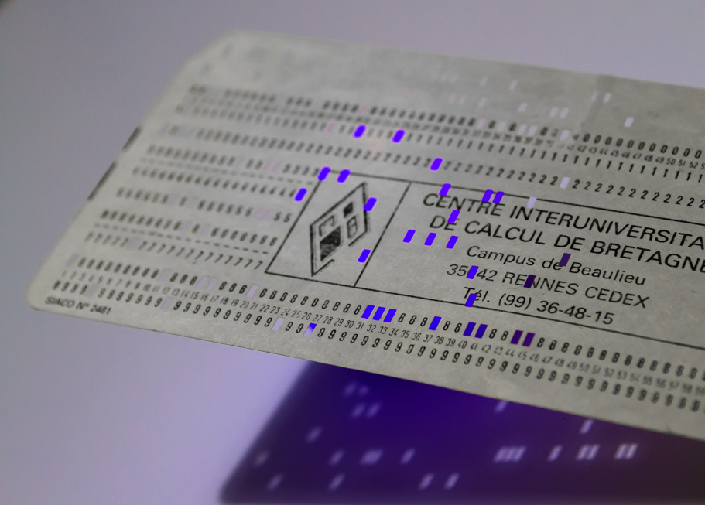
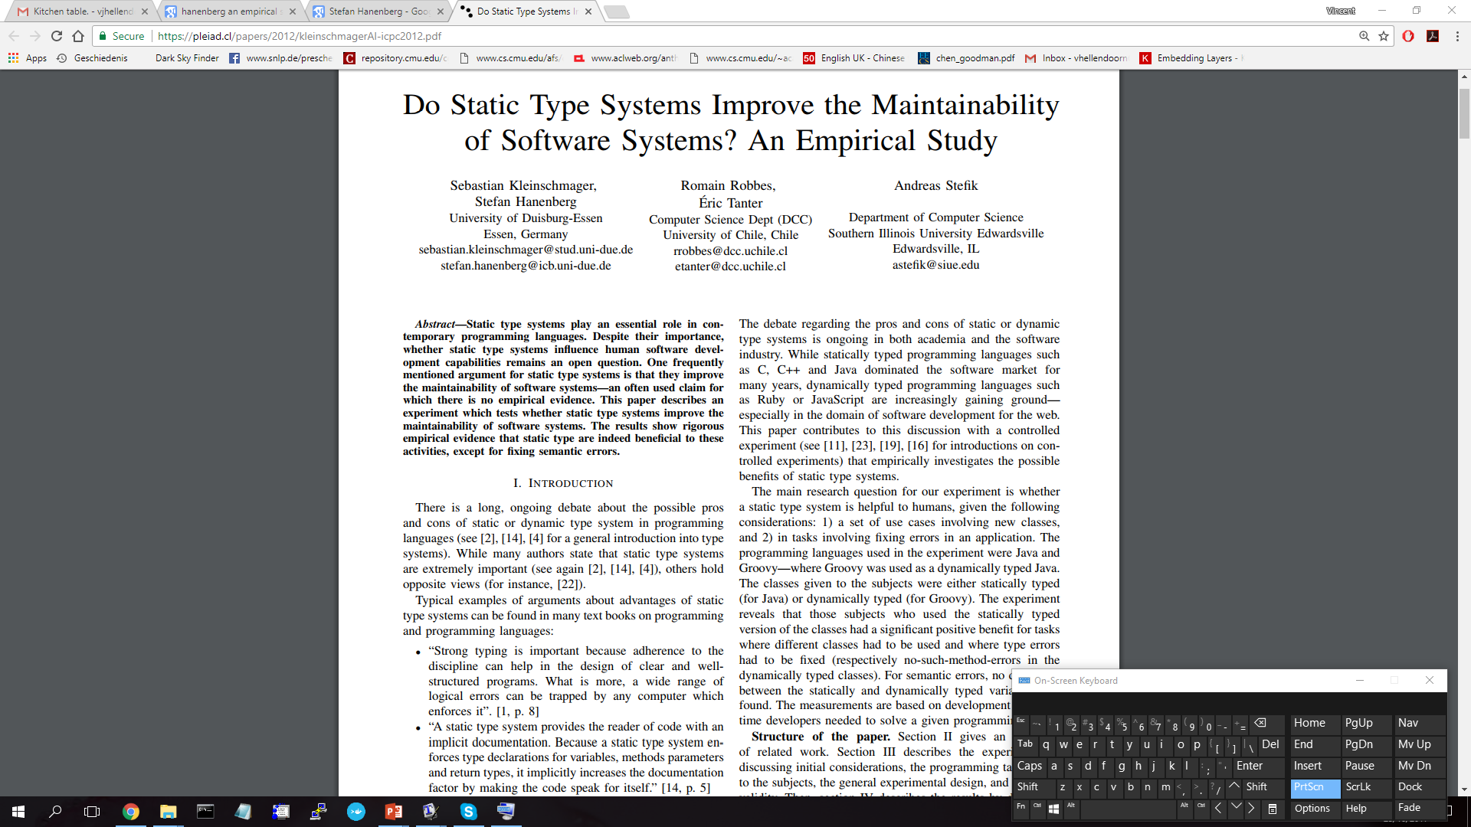
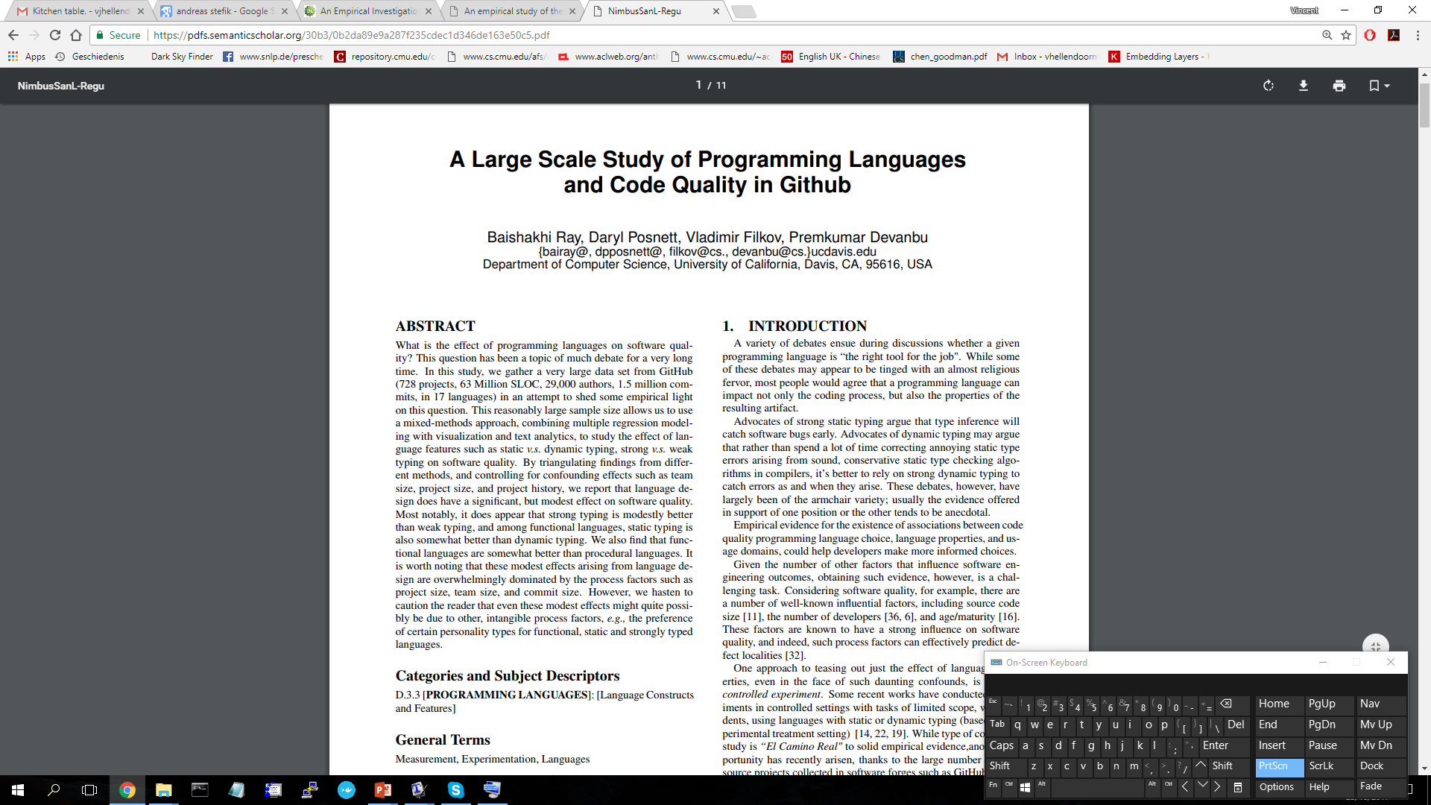
Language Wars

Slide 3
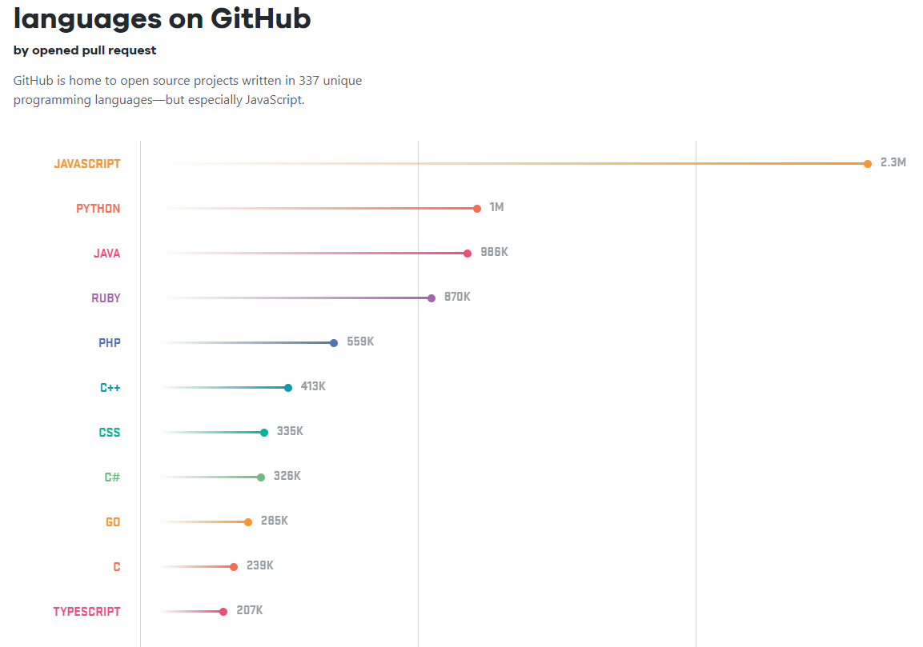
Popular Vote

Slide 4
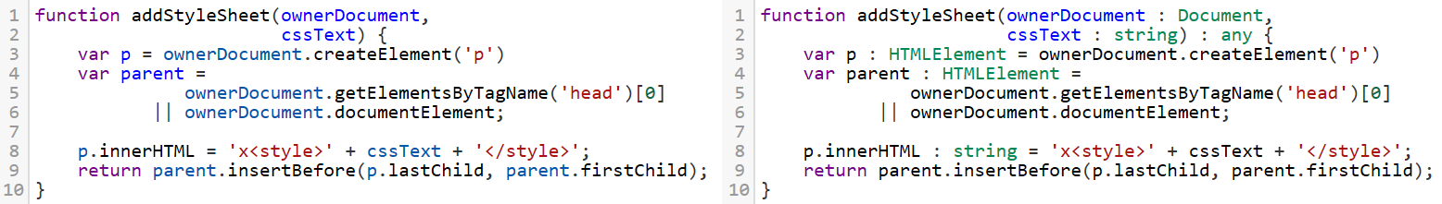
Challenger
JavaScript
TypeScript
Notes:
Not just annotations!
Transpile

Slide 5
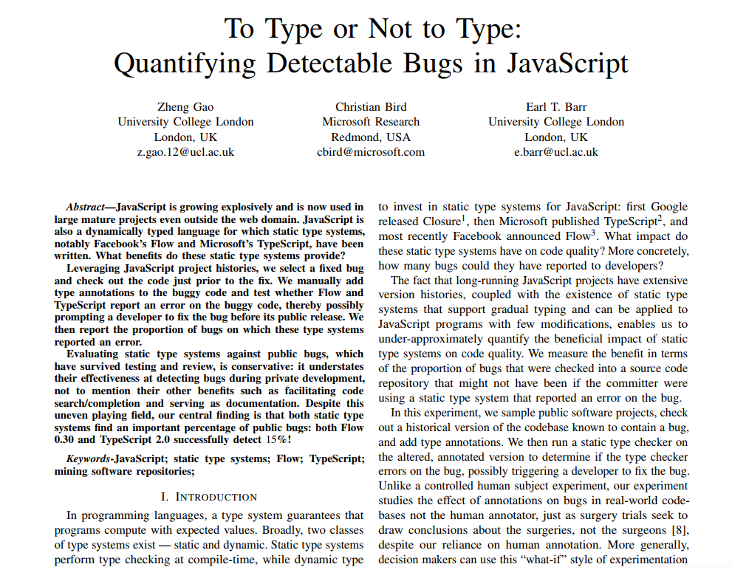
Challenger
JavaScript
TypeScript
Notes:
Real implications
It makes sense, then,

Slide 6
Civic Duty
JavaScript
Notes:
Also Python

Slide 7
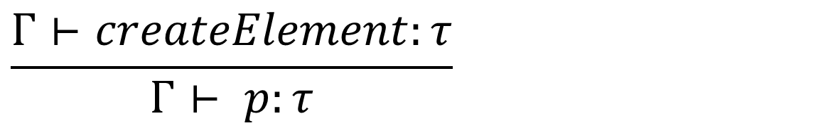
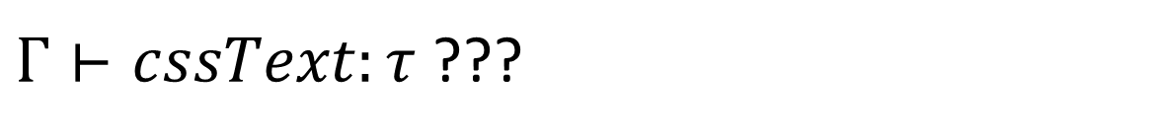
Civic Duty
JavaScript
Formal
$$\frac{Γ⊢createElement:τ}{Γ⊢ p:τ}$$
$Γ⊢cssText:τ$ ???

Slide 8
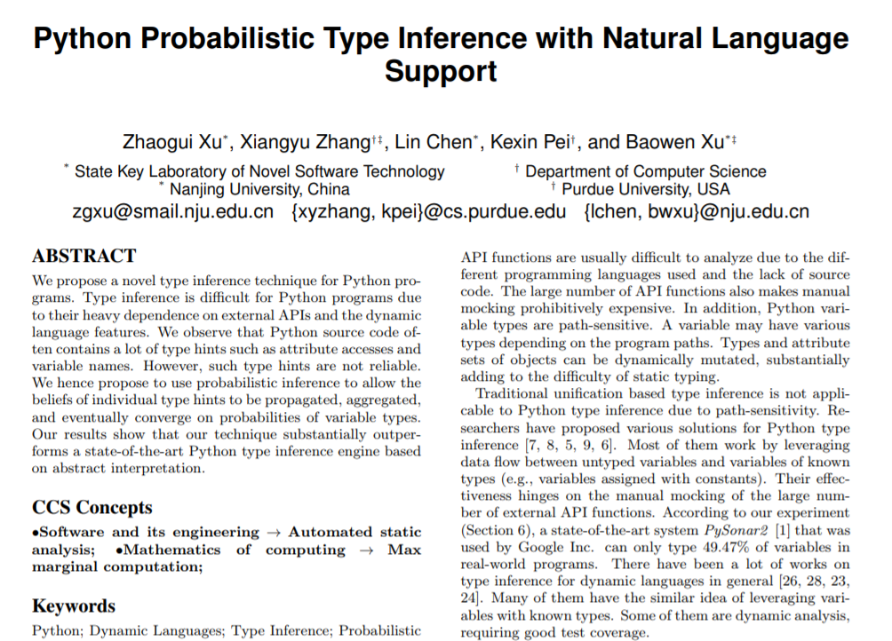
Civic Duty
JavaScript
Heuristics

Slide 9
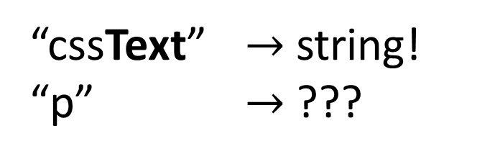
Civic Duty
JavaScript
Heuristics
“cssText” $→$ string!
“p” $→$ ???

Slide 10
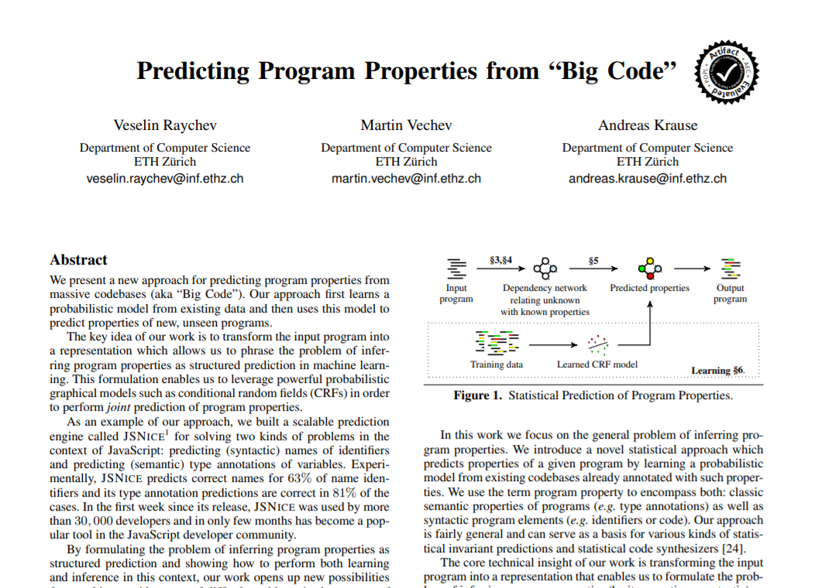
Civic Duty
JavaScript
Learn it

Slide 11
Think Backwards
JavaScript
TypeScript

Slide 12
Specs
Non-goals
Deep learning breakthrough
“Solve” type inference
Goals
Powerful learning approach
Complement the compiler

Slide 13
Battleplan

Slide 14
Data

Slide 15
Exempli Gratia
TypeScript

Slide 16
Exempli Gratia
TypeScript

Slide 17
Exempli Gratia
TypeScript
JavaScript/TypeScript

Slide 18
Mining Expedition
Types only
Top 1000
TypeScript Repositories
Compile
&
Filter
Aligned
Type-stripped code

Slide 19
Mining Returns
Category | Projects | Tokens
Train | 620 | 18M
Held-out | 78 | 3.9M
Test | 78 | 1.9M
Notes:
Inter-project

Slide 20
Mining Returns
any
string
number
void
boolean

Slide 21
Model

Slide 22
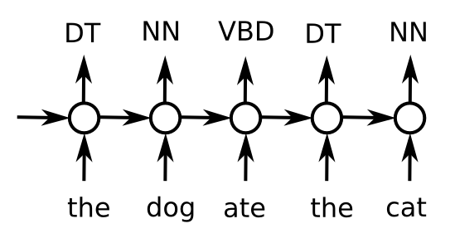
Tag!
https://i.stack.imgur.com/6pdIT.png
Notes:
Lots more tags
Loooong sequences

Slide 23
Tag!
- num - - - - num - num - - -
let a = 1 ; let b = a + 1 ;
Notes:
From/To
Type ALL identifiers

Slide 24
Tag!
- num - - - - num - num - - -
Project to Types
Bi-Directional GRU
Bi-Directional GRU
Embedding
let a = 1 ; let b = a + 1 ;

Slide 25
Tag!
- num - - - - num - num - - -
Project to Types
Bi-Directional GRU
Bi-Directional GRU
Embedding
let a = 1 ; let b = a + 1 ;

Slide 26
Results

Slide 27
Battlegrounds
Real annotations
Vs. naïve baseline, compiler
Pure JavaScript
Vs. JSNice

Slide 28
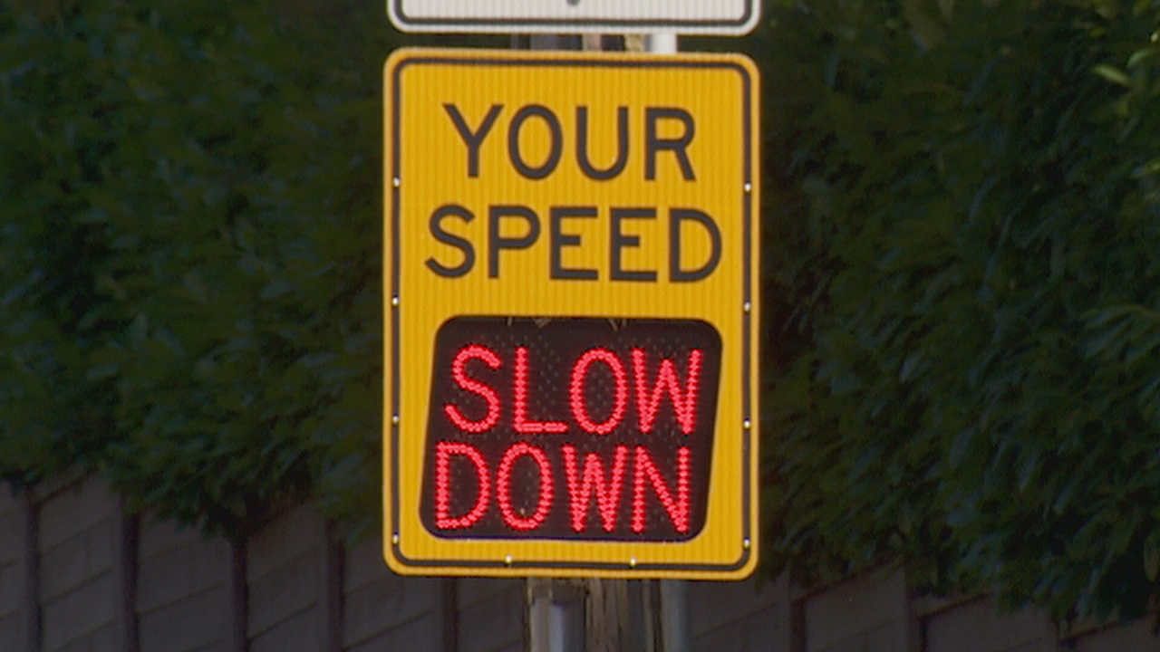
Results

Slide 29
Results – Annotations

Slide 30
Results – Annotations

Slide 31
Results – Annotations

Slide 32
Results – Annotations

Slide 33
Results
Any confidence

Slide 34
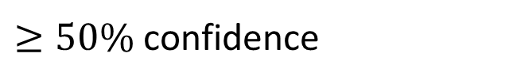
Results
$≥50\%$ confidence

Slide 35
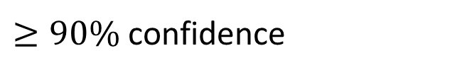
Results
$≥90\%$ confidence

Slide 36
Results

Slide 37
Results – JSNice
JavaScript Only
20 functions, 167 annotations

Slide 38
Results – JSNice

Slide 39
Results – JSNice

Slide 40

Why not Both?
Notes:
JSNice Precise, Unconfident
DeepTyper Intuitive, imprecise

Slide 41
Results – JSNice
Notes:
Crux
With the right training setup

Slide 42
Outcomes
What did we do?
Train for type inference
Highly complementary
What’s next?
Towards full type inference
Interact with Compiler

Slide 43

Questions?
What did we do?
Train for type inference
Highly complementary
What’s next?
Towards full type inference
Interact with Compiler
Code at: https://github.com/DeepTyper/DeepTyper
Contact: vhellendoorn.github.io $⋅$ vhellendoorn@ucdavis.edu

